Slide 1
Imperfect Competition

Slide 2
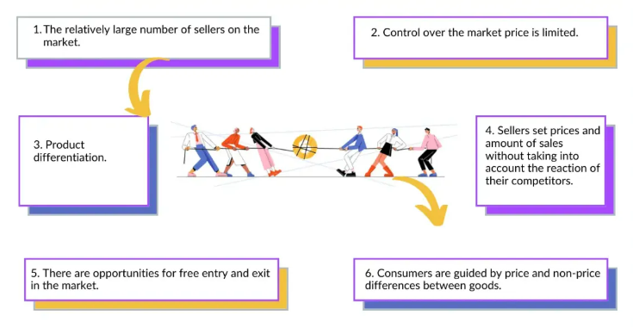
Monopolistic Competition
Notes:
What is a Monopolistic Competition?
Monopolistic competition definition says that it stands for an industry in which many firms service similar products which are not a perfect substitute. There are very low barriers to entry or exit in monopolistic competition. In this competition, one firm decision doesn't affect the whole industry or another firm. Monopolistic competition is just related to the business strategy of brand variation.
Monopolistic competition means monopoly plus a perfect competition. This market is a perfect mixture of monopoly and perfect competition. It combines elements of both in a theoretical state. In this competition, every brand tries to make its own unique product, and they make it slightly different from other brands of the same item. While we are judging them roughly, there is no difference as such. Although when we examine them closely, we can find some little difference between different brand products. If we take the soap brands of India as monopolistic competition examples, it can be easily revealed the idea of monopolistic competition. Though all the soap brands such as Lux, Dove, Vivel, Fiama, Pears produce the same item, They contain some different features from others in their product to make it unique.
Following are the main characteristics of Monopolistic Competition—
1.Large Number of Firms and Buyers: Firm producing differentiated product and sellers are
large in numbers in monopolistic competition.
2. Product Differentiation: Product differentiation is the main feature of monopolistic competition. Product differentiation means that product of different types, brands, and qualities will be available to customers in a fixed time period. Product differentiation occurs when buyer of product can differentiate between two products. In this, firms are in large number but their
products are different from each other in anyway, but these products are close substitutes of each other. Product differentiation is obtained due to characteristic of product like shape, measurement, colour, durability, quality etc. There are many examples of product differentiation like bath soaps Lux, Godrej, Camay, Rexona, etc.
3. Freedom of Entry and Exit of Firms: In the situation of monopolistic competition there is freedom of entry and exit of firms in the industry like perfect competition. It should be noticed that Chamberlin has used group at the place of industry for group of firms which produce differentiated products under the monopolistic competition. However, some level of barrier can be there is there is high selling cost involved within the industry.
4. Selling Cost: An important characteristic of monopolistic competition is that every firm spends more money in promoting its product under it. Firm gives advertisements in newspapers, cinemas, magazines, radio, T.V. etc. for selling its product in the maximum amount. The investment done on all these is called as Selling Costs.
5. Price Control: Every firm has limited control on the cost of product. Average income and limit end income curve of a firm fall down like monopoly in monopolistic competition. It means that in this situation, firm can slow down the price for selling more products and raise price for fewer products. In monopolistic competition, a firm has control on cost of its production due to the product differentiation. But due to the availability of close substitute of opposite product firms do not have full control on cost in monopolistic competition. The cost of every firm is affected by cost policy of its competitors in market up to the certain limit.
6. Imperfect Knowledge: In the situation of monopolistic competition, buyers, sellers of products, and owners of sources do not have knowledge of different prices of product. The reason is that comparison between productions of different firms is not possible due to product differentiation. Customers are fond of the production of any one specific firm. They only buy the production of that firm even if it costs higher than others. In this way even sources of production are not able to know fully that how much the different firms are costing to the sources of services.
8. Non-Price Competition: The main characteristic of monopolistic competition is that under it different firms without changing the costs of products compete with each other like the example of companies producing ‘Surf’ and ‘Ariel’. If you take a box of ‘Surf’, you can get a glass utensil similarly, with the box of ‘Ariel’ you will get the steel spoon. In this way, firms, by providing different types of facilities and products etc. to customers to attracts them towardtheir products. This type of competition is called as Non-Price Competition.

Slide 3
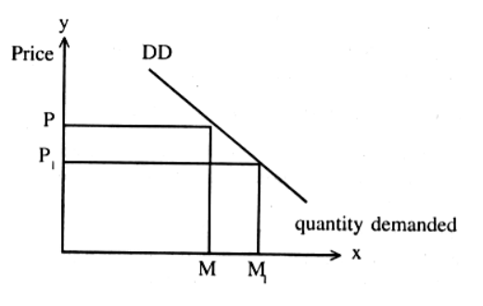
Demand Curve under Monopolistic Competition
There are a large number of sellers under Monopolistic Competition who sells closely related but differentiated products in the market.
It makes the demand curve of a monopolistic competition market downward sloping.
Notes:
The buyers in monopolistic market compare the prices of the products along with the perceived quality of each. Hence, there is competition between sellers for the market share. So you can see that in this market structure, a group of firms compete against each other while remaining monopolists of their own products because of the uniqueness of their product.
The products in the monopolistic market are not homogeneous. Therefore, it is impossible to determine the market demand for the product precisely. In fact, it is difficult to determine the average revenue curve of the industry as well.
Since the firms are not providing the same product, defining an industry becomes complex too. The best definition is a group of firms who sell products which are close substitutes of each other.
Given the nature of market structure, we know that a monopolistic firm can sell more products/output only when it reduces its price. This concept can be understood with the help of a graph/demand curve of a firm under Monopolistic Competition.
As shown in the above demand curve, the output of the firm under Monopolistic Competition is measured along the X-axis, and its revenue and product’s price is measured along the Y-axis. At price OP, the seller of the Monopolistic Competition can sell OM quantity of the output. The demand for the product will increase to OM1 only when the price of the product is reduced to OP1. Therefore, the demand curve of the firms under Monopolistic Competition has a negative slope, or they can sell more products only when the price of the product decreases.
Therefore, under Monopolistic Competition, MR < AR.

Slide 4
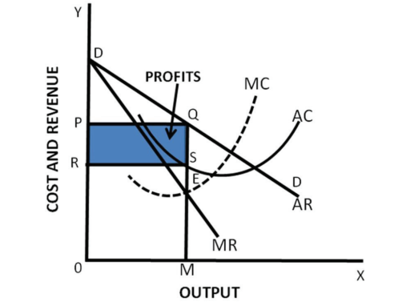
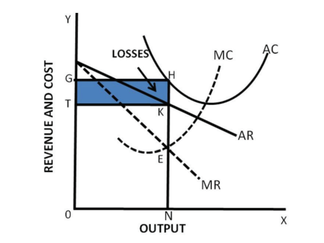
Individual’s firm equilibrium: Short-run analysis
Notes:
Assuming the conditions with respect to all substitutes such as their nature and prices being constant, the demand curve for the product of a firm will be given. We further suppose that only variables are price and output in respect of which equilibrium adjustment is to be made. The individual equilibrium under monopolistic competition is graphically shown in the above figure. DD is the demand curve for the product of an individual firm, the nature and prices of all substitutes being given. This demand curve DD is also the average revenue (AR) curve of the firm. AC represents the average cost curve of the firm, while MC is the marginal cost curve corresponding to it. It may be recalled that average cost curve first falls due to internal economies and then rises due to internal diseconomies.

Slide 5
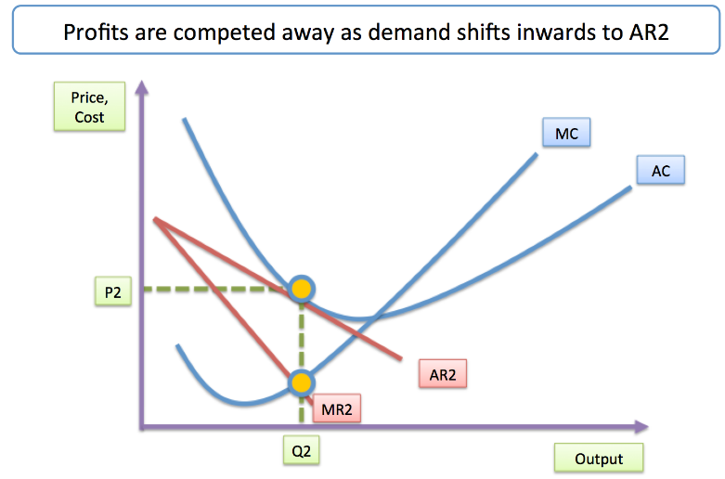
Long-run equilibrium with Monopolistic Competition
Notes:
In the long run, there is a gradual decrease in the profits of the firms. This is because in the long run, several new firms enter the market due to freedom of entry. When these new firms start production the market supply would increase and the price would fall. This would automatically increase the level of competition in the market. Consequently, AR curve shifts from right to left and supernormal profits are eliminated. The firms will be able to earn normal profits only. In the long run, the AR curve is more elastic than that of in the short run. This is because of an increase in the number of substitute products in the long-run. As new firms enter the business, the market share of the firm will reduce. The long-run equilibrium of monopolistically competitive firms is achieved when average revenue is equal to average cost. In such a case, the firms receive normal profits. In Fig. , P 2 is the point at which AR curve touches the average cost curve (LAC) as a tangent. P2 is regarded as the equilibrium point. In the present case average cost is equal to average revenue that is MP. Therefore, in long run, the profit is normal. In the short run, equilibrium is attained when marginal revenue is equal to marginal cost. However, in the long run, both the conditions (MR=MC and AR=AC) must hold to attain equilibrium.

Slide 6
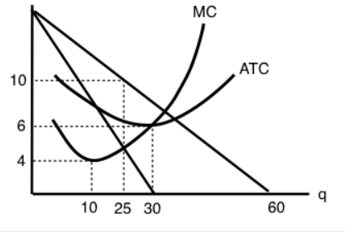
Review Question
How many units of output should this firm produce, in order to maximize profits?
Notes:
Profit maximization point: Quantity=25
Total Revenue= 25*10= 250
Minimum efficient point is reached when firm is producing 30 units of the commodity. This is the point where average cost of production reaches its minimum point.

Slide 7
Review Question
Q: Which of the following statements best describes a characteristic of monopolistic competition?
Firms in monopolistic competition produce identical products.
Firms in monopolistic competition are price takers.
Firms in monopolistic competition face barriers to entry.
Firms in monopolistic competition engage in perfect price discrimination.
Notes:
Answer: C

Slide 8
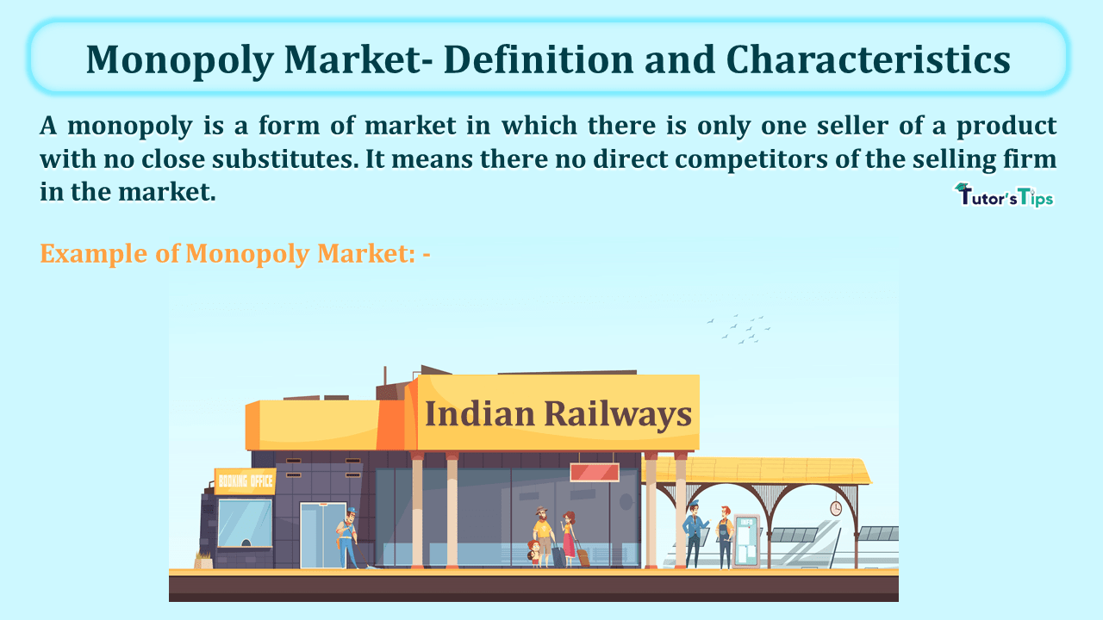
Monopoly
Notes:
A monopoly refers to a situation where one company or entity has complete control over the supply of a particular product or service in a market. This means that the monopolistic company is the only seller in the market, giving it significant power to set prices and control the availability of the product or service.

Slide 9
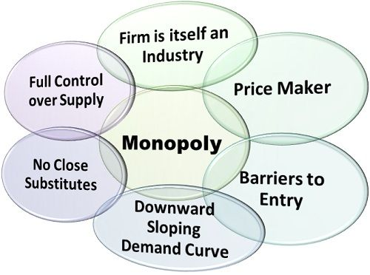
Characteristics of Monopoly Market
Notes:
Sole Trader: A monopoly market is wholly captured by a single seller or firm which provides goods with no close substitutes at all. The whole market is regulated by individual sellers having complete influence over the supply of products. A trader or firm from an industry with a monopoly as the whole output of the product is only dependent upon them.
Price Maker: The monopolist is the price maker being the sole king of the industry. The price of the product is set by the seller himself as there is no other competitor operating in the market. Due to the absence of competition, there is no one to challenge the price determined by the seller and therefore become the final price of the product in the market.
Barrier to entry and exit: A monopoly market is characterized by a high barrier to entry/exit of new entrants. The barriers involved in a monopolistic market are government licenses, copyrights and patents, resource ownership, and large startup costs. Other companies find difficulty in entering the monopolistic market as whole production and supply of particular product comes under the control of a single supplier.
Unique product: The product or service offered by a firm in a monopolistic market is unique with no close substitutes. Monopoly traders possess a patent of that specific product under which no close substitute can be manufactured or sold by other firms in the market.
Price discrimination: There is a high possibility of price discrimination in a monopolistic market. A single trader can change the price of the product without any challenge from anyone. He may charge different prices from different customers that are charging higher prices from rich people and low prices from poor customers.
Downward sloping curve: Under the monopoly market, the demand curve is downward sloping. It signifies that a firm can generate higher profits by raising the sales level which is possible via bringing down the price of the product.
Profit maximizer: A company operating in a monopolistic market aims to maximize its profit. Due to the absence of competition in the market, a firm can set a higher price than what would have been charged in a competitive market. Therefore, the price decided by monopolistic will be referred to as market price.

Slide 10
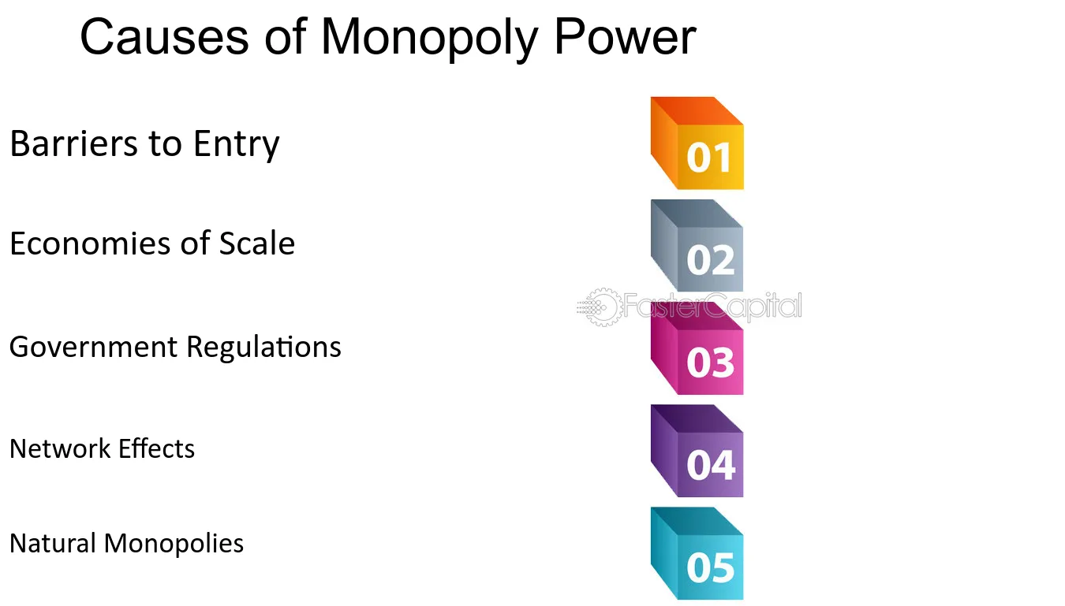
Notes:
Monopoly refers to a market situation where there is only one seller or producer for a particular product or service, effectively giving them complete control over the market. There are several causes of monopoly, and here are some of the key ones along with examples:
1.Barriers to Entry: Barriers that prevent new firms from entering the market can lead to monopolies. These barriers can include high startup costs, economies of scale, legal barriers such as patents or licenses, and control over essential resources.
Example: Microsoft's operating system, Windows, has maintained a near-monopoly in the PC operating system market due to high barriers to entry, including brand loyalty, network effects, and the complexity of creating an alternative operating system that is compatible with existing software and hardware.
2. Economies of Scale: Firms that can produce at a lower average cost as they scale up production may drive competitors out of the market, leading to a monopoly.
Example: Utility companies, such as those providing electricity or water, often enjoy natural monopolies due to economies of scale. It's more cost-effective to have one provider serving an area rather than multiple companies duplicating infrastructure.
3. Government Regulation and Licensing: Sometimes, government regulations or licensing requirements can create monopolies by limiting the number of firms allowed to operate in a particular market
Example: Many local governments grant exclusive licenses to operate utilities such as cable television or waste management services, effectively creating monopolies in those areas.
4. Network Effects: In some industries, the value of a product or service increases with the number of users. This can lead to a "winner-takes-all" scenario where one firm dominates the market.
Example: Social media platforms like Facebook benefit from network effects. The more users on the platform, the more valuable it becomes to users, making it difficult for new competitors to enter and challenging existing ones.
5. Control of Key Resources: Monopolies can arise when a single firm controls access to crucial resources necessary for production. This control allows the firm to dictate prices and restrict competition.
Example: De Beers historically held a monopoly over the diamond market by controlling the majority of diamond mines worldwide. This control allowed them to regulate the supply of diamonds and maintain high prices.
6. Patents and Intellectual Property Rights: Legal monopolies can be granted through patents, copyrights, and other forms of intellectual property rights, giving the holder exclusive rights to produce or sell a particular product or service.
Example: Pharmaceutical companies often hold patents on new drugs, granting them a monopoly on the production and sale of those drugs for a certain period. This allows them to recoup their research and development costs and make a profit.
These are just a few examples of how monopolies can arise due to various factors. Each situation is unique, and the specific causes of monopoly can vary depending on the industry and market dynamics

Slide 11
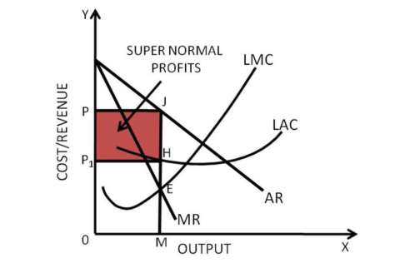
Long-run Equilibrium in case of Monopoly
Notes:
Few examples of monopoly firms are as follows: –
Microsoft: Microsoft company launched a distinguished user-friendly operating system in market at times when only few operating systems were available in market. It is due to this that Microsoft brand becomes a key holder of this resource in market.
There are other operating systems as well in the market such as Unix and Linux which are not as user-friendly as windows. This is the main reason why windows cover almost 90% of the market at present.
Raw Diamond Company-De Beers: De Beers have ownership of most of the mines all around the globe. Majority of African mines are under their control since 19th century. It makes De beers, a sole raw diamond seller in the world since late 19th century to initials of 21st century.
Various business strategies are employed by the brand in order to retain its position as the largest owner of raw diamond sellers around the globe.
The monopolist can enjoy supernormal profit in even long –run as there is lack of competition in the market.

Slide 12
Advantages of Monopoly:
Economies of Scale
Research and Development
Infrastructure Development
Disadvantages of Monopoly:
Higher Prices
Reduced Choice
Allocative Inefficiency
Lack of incentive for Quality improvement
Social Inequity
Notes:
A monopoly refers to a situation in which a single company or entity dominates the entire market for a particular product or service. While monopolies often evoke negative connotations due to their potential to limit competition and harm consumers, they can also offer certain advantages under specific circumstances. Here are some advantages of monopolies, along with examples:
1. Economies of Scale: Monopolies can achieve significant economies of scale by producing goods or services in large quantities. This allows them to spread their fixed costs over a larger output, resulting in lower average costs per unit. As a result, monopolies can often offer products or services at lower prices than would be possible in a competitive market.
Example: Microsoft's Windows operating system has long been dominant in the desktop operating system market, allowing it to spread its development and marketing costs over a massive user base. This has contributed to relatively lower costs for consumers compared to alternative operating systems.
2. Innovation and Research: Monopolies may have more resources and incentives to invest in research and development (R&D) to innovate and improve their products or services. With no immediate threat of competition, they can focus on long-term projects without the pressure to quickly recoup investments.
Example: Pharmaceutical companies often hold monopolies on certain life-saving drugs due to patents. This monopoly position allows them to invest heavily in R&D for new medications, knowing they can potentially recoup their investments through exclusive sales.
3. Quality Control: Monopolies can exert tight control over the production process, ensuring consistent quality in their products or services. With no competitors to lure away customers, they have a strong incentive to maintain high standards.
Example: De Beers, historically dominating the diamond market, maintained strict quality control over its diamonds, ensuring consistent clarity and cut across its products.
4. Infrastructure Development: In industries where substantial infrastructure investments are required, a monopoly may be better equipped to make these investments efficiently. This can lead to the development of essential infrastructure that might not be viable under competitive conditions.
Example: Utility companies, such as electricity or water providers, often operate as regulated monopolies in specific geographic regions. This arrangement allows them to invest in the necessary infrastructure (e.g., power plants, distribution networks) to provide reliable service to customers.
5. Stability of prices
The prices in a normal competitive market, are set by the forces of competition as well as the market forces of demand and supply. In a monopoly on the other hand, since there is no competition, there being only one seller of a good in the market, the prices are determined by the seller themselves as per their wishes and whenever they would like to change the price. As a result, the prices of a monopoly remain much stable as compared to a competitive market.
6. Source of revenue
Despite the fact that monopolies are often a source of restricted competition and entry of other sellers in the market, they are still encouraged because monopolies can earn good amounts of profits, being the only sellers in the markets and hence, they become good sources of revenue for the government which benefits the society as a whole.
7. Profits
As already discussed, a monopoly refers to a single seller operating and selling a good in the market of a large number of buyers. Since there are no other sellers of such good in the market, the entire demand of such good is enjoyed by the one seller and as a result, monopolies become able to make a considerably massive amount of profits through their sales in the markets.
8. Source of essential public utilities
Monopolies are often state controlled and run companies that help in producing and making available goods that are essential and important for public utilities that operate on large scale to provide the essential goods and services to the people in the community. There are many monopolies in a state that are government owned and controlled such as those providing public transport facilities, water and electricity resources, etc.
Disadvantages
1. Exploitation of consumers
Since there is only one seller in the market in a monopoly, the entire power of providing the good, at a certain price or at a certain quality remains in the hands of the seller and no power lies in the hands of the consumers. Also, there are no market and competitive forces to keep the goods of a monopoly in check in terms of price and quality. Hence, such a market structure can be exploitative for the consumers in the market.
2. Price discrimination
Since Monopolies decide their own prices in the markets, with no competition to worry about, it has been seen often that the seller tends to charge different prices from different sets of consumers, causing a discrimination in the prices.
3.Quality of goods
Since there is no competition in such a market, a monopoly can often provide low or inferior quality of goods to save their costs of production and make more profits, thereby causing a loss to the consumers.
4. Allocation of resources
The allocation of resources in a monopoly is often biased and distorted because in the production of such goods, the resources can often not be acquired by small firms or sellers or at least by a significant number of firms in the market, providing a benefit to the seller to be able to control and restrict the supply as well as competition in the markets.
5. Unfair trade practices
It is well-known that a monopolistic market often is a barrier to new entrants in the markets. In a monopoly, in order to keep enjoying the various benefits of being the only seller in the market, and to keep making the massive profits, monopolies often engage into unfair trade practices to ensure that competitors in the market are ousted and do not impact their business in the markets.
6. Reduced Choice: In a monopoly, consumers have limited or no choice in the products or services available to them. This lack of choice can lead to decreased variety and innovation as the monopolist has little incentive to cater to diverse consumer preferences.
7. Social Inequality: Monopolies can exacerbate social inequality by concentrating wealth and power in the hands of a few individuals or entities. This concentration of economic power can lead to unequal distribution of resources and opportunities, widening the gap between the rich and the poor.

Slide 13
Review Question
Which of the following statements best illustrates a consequence of monopoly power?
A) Increased consumer choice and product diversity.
B) Lower prices due to intense price competition.
C) Limited output and higher prices compared to competitive markets.
D) Greater efficiency and innovation in the industry.
Notes:
Answer: Statement C

Slide 14
Degree of Price Discrimination
1. First-Degree Price Discrimination (Perfect Price Discrimination):
In first-degree price discrimination, also known as perfect price discrimination, each customer is charged the maximum price they are willing to pay for the product or service.
2. Second-Degree Price Discrimination:
Second-degree price discrimination involves charging different prices based on the quantity or level of consumption of the product or service.
3. Third-Degree Price Discrimination:
Third-degree price discrimination involves charging different prices to different groups of customers based on their characteristics or willingness to pay.
Notes:
Price discrimination typically occurs in three main forms: first-degree price discrimination, second-degree price discrimination, and third-degree price discrimination. Let's explore each type with easy examples:
First-Degree Price Discrimination:
First-degree price discrimination, also known as perfect price discrimination, involves charging each customer the maximum price they are willing to pay. This means that the seller captures the entire consumer surplus for themselves.
Example: Suppose a car dealership uses first-degree price discrimination. When a customer walks into the dealership, the salesperson assesses their willingness to pay based on factors such as their income, preferences, and urgency to buy. The salesperson then offers each customer a personalized price for the car, maximizing the revenue from each sale. Essentially, each customer pays a different price based on their individual valuation of the car.
2. Second-Degree Price Discrimination:
Second-degree price discrimination involves charging different prices based on the quantity or volume of goods or services purchased. Typically, the more a customer buys, the lower the unit price.
Example: Consider a theme park that offers tiered pricing for admission tickets. The park may sell single-day tickets at one price, but offer discounted rates for purchasing multiple days or for purchasing tickets in bulk for a group. In this case, customers who buy more tickets pay a lower average price per ticket, incentivizing them to purchase in larger quantities.
3. Third-Degree Price Discrimination:
Third-degree price discrimination involves charging different prices to different groups of customers based on their characteristics, such as age, location, or income level. The seller must be able to separate customers into distinct groups with different demand elasticities.
Example: An airline may practice third-degree price discrimination by offering discounted fares to senior citizens or students. The airline recognizes that these groups typically have lower incomes and are more price-sensitive than other travelers. By offering lower prices specifically to these groups, the airline can attract more passengers while still charging higher fares to less price-sensitive customers.
In each of these examples, the seller adjusts their pricing strategy to capture more of the consumer surplus, maximizing their revenue and profits. While price discrimination can be a profitable strategy for businesses, it can also raise concerns about fairness and equity among consumers.

Slide 15
Peak-load pricing
Peak-load pricing involves charging higher prices during periods of peak demand and lower prices during off-peak periods.
Firms exploit differences in demand elasticity across different time periods to maximize revenue.
Examples include surge pricing for ride-sharing services during peak hours or off-peak pricing for electricity consumption.
Notes:
Imagine a ski resort that experiences varying levels of demand for lift tickets throughout the ski season. Typically, demand is highest during weekends and holidays when more people have time off from work or school to go skiing. To optimize revenue and manage crowd levels, the ski resort implements peak load pricing:
Peak Period: During weekends and holidays when demand for skiing is highest, the ski resort charges higher prices for lift tickets. This reflects the increased demand for skiing during these peak periods and allows the resort to capitalize on the willingness of customers to pay more for skiing experiences during these times.
For example, on Saturdays and Sundays during the peak winter season and major holidays, the ski resort charges 800 rupees for a full-day lift ticket. They know that during holidays, the price elasticity of demand is relatively inelastic as most of them will be getting off only on weekends.
Off-Peak Period: During weekdays when demand for skiing is lower due to fewer people being available to ski, the ski resort offers discounted prices for lift tickets. This encourages customers to visit the resort during off-peak times, spreading out demand and reducing overcrowding on the slopes during peak periods. It is also because demand on weekdays is relatively elastic.
For example, from Monday to Friday during non-holiday periods, the ski resort charges 500 rupees for a full-day lift ticket.
By implementing peak load pricing, the ski resort achieves the following objectives:
It maximizes revenue by charging higher prices during peak periods when demand for skiing is highest and customers are willing to pay more for lift tickets.
It incentivizes customers to visit the resort during off-peak times by offering lower prices, thereby spreading out demand and reducing congestion on the slopes during peak periods.
It ensures that customers who value skiing experiences during peak times pay a higher share of the costs, while those who choose to ski during off-peak times benefit from discounted prices.
Overall, peak load pricing allows the ski resort to effectively manage demand, optimize revenue, and enhance the skiing experience for customers throughout the ski season.

Slide 16
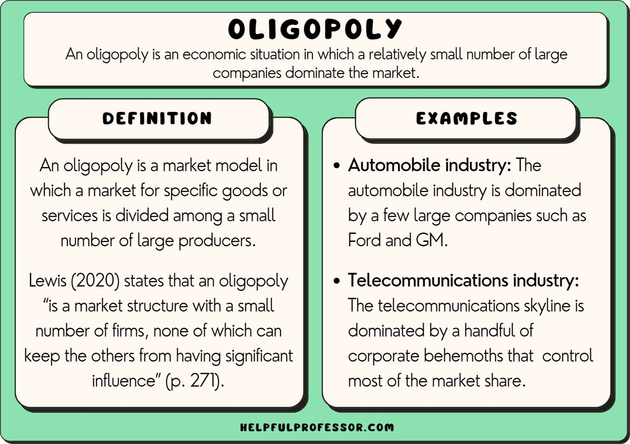
Oligopoly
Notes:
An oligopoly is a market structure characterized by a small number of large firms dominating the industry. These firms have significant market power, which allows them to influence prices and output levels. Oligopolistic industries often exhibit interdependence among competitors, where the actions of one firm can impact the decisions of others. Here's a simple example of an oligopoly:
Example: Soft Drink Industry
Consider the soft drink industry, which is dominated by a few major players such as Coca-Cola and PepsiCo. These companies control a significant portion of the market share for carbonated beverages, sports drinks, and bottled water. The industry exhibits characteristics of an oligopoly due to the following reasons:
Few Dominant Firms: Coca-Cola and PepsiCo are the two largest competitors in the soft drink industry, holding substantial market shares globally. While there are other smaller players in the market, these two firms dominate the industry and wield significant market power.
Interdependence: The decisions made by Coca-Cola and PepsiCo regarding pricing, advertising, and product innovation have a direct impact on each other's strategies and the overall market dynamics. For example, if Coca-Cola decides to lower the price of its flagship cola, PepsiCo may respond by matching or undercutting Coca-Cola's prices to maintain its market share.
Non-Price Competition: In oligopolistic markets like the soft drink industry, firms often engage in non-price competition to differentiate their products and attract customers. Coca-Cola and PepsiCo invest heavily in marketing, branding, and product development to build brand loyalty and differentiate their beverages from competitors.
Barriers to Entry: The soft drink industry has significant barriers to entry, including high capital requirements for manufacturing and distribution, extensive marketing costs, and established brand loyalty among consumers. These barriers make it difficult for new entrants to compete with established firms like Coca-Cola and PepsiCo, further reinforcing the dominance of existing players.
In summary, the soft drink industry serves as a simple example of an oligopoly, where a small number of large firms dominate the market, exhibit interdependence in their decision-making, and engage in non-price competition to maintain their market positions.

Slide 17
Types of Oligopoly
Pure Oligopoly
Differentiated Oligopoly
Collusive Oligopoly
Price Leadership Oligopoly
Stackelberg Oligopoly
Notes:
1.Pure Oligopoly: In a pure oligopoly, firms compete primarily on price, with little differentiation in their products or services. Prices are often set based on the actions of competitors. This type of oligopoly tends to result in price wars and intense competition.
Example: The market for crude oil is a pure oligopoly, with a small number of major oil-producing countries, such as Saudi Arabia, Russia, and the United States, controlling the majority of the global oil supply. These countries often engage in price competition to gain market share.
2. Differentiated Oligopoly: In a differentiated oligopoly, firms differentiate their products or services through branding, quality, features, or other attributes. While price competition may still occur, firms focus more on non-price factors to attract customers.
Example: The smartphone industry is a differentiated oligopoly, with companies like Apple, Samsung, and Huawei offering smartphones with varying features, designs, and price points. These firms compete not only on price but also on brand image, technological innovation, and customer service.
3. Collusive Oligopoly: In a collusive oligopoly, firms collude to coordinate their actions and maximize collective profits. Collusion may involve explicit agreements, such as price-fixing or output restrictions, or tacit understandings among competitors.
Example: The Organization of the Petroleum Exporting Countries (OPEC) is a prime example of a collusive oligopoly. OPEC member countries, including Saudi Arabia, Iran, and Venezuela, collaborate to control the production and pricing of oil in order to influence global oil markets.
4. Price Leadership Oligopoly: In a price leadership oligopoly, one dominant firm (the price leader) sets the price, and other firms in the market follow its lead. The price leader's actions serve as a signal to other firms, simplifying pricing decisions for the rest of the industry.
Example: The airline industry often operates as a price leadership oligopoly, with one major carrier setting prices for certain routes or services, and other airlines adjusting their prices accordingly. For instance, if a leading airline raises fares for a particular route, other airlines may follow suit.
5. Stackelberg Oligopoly: In a Stackelberg oligopoly, firms have a sequential order of decision-making, where one firm (the leader) determines its output or price first, and other firms (the followers) then respond to the leader's decision. This sequential decision-making process can lead to strategic advantages for the leader.
Example: The automobile industry can exhibit characteristics of a Stackelberg oligopoly. For instance, if one automaker (the leader) announces plans to introduce a new fuel-efficient vehicle, other automakers (the followers) may adjust their production plans or strategies in response to the leader's actions.
These are some of the main types of oligopoly, each with its own characteristics and implications for market behavior. The specific type of oligopoly observed in a particular industry depends on factors such as the level of product differentiation, market concentration, and the nature of competition among firms.

Slide 18
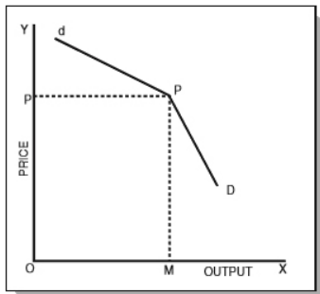
Kinked Demand Curve: Oligopoly
Notes:
The kinked demand curve is a concept used in economics to describe the behavior of firms in oligopoly markets. It suggests that the demand curve faced by a firm has a "kink" or discontinuity at the current market price. This kinked demand curve theory is used to explain price rigidity and stability in oligopolistic industries where a small number of large firms dominate the market.
Here's how the kinked demand curve theory works:
Above the Price Kink: In this range, the demand curve facing the firm is relatively inelastic. This means that consumers are not very responsive to changes in price, and as a result, changes in the firm's price lead to minimal changes in the quantity demanded by consumers. The demand is relatively inelastic because consumers may perceive few substitutes for the firm's product, or they may have limited options due to brand loyalty or switching costs.
Below the Price Kink: In this range, the demand curve facing the firm becomes relatively elastic. This means that consumers are highly responsive to changes in price, and small changes in price lead to significant changes in the quantity demanded. The demand is relatively elastic because consumers have more alternatives available, and they are more likely to switch to competitors if prices are lowered.
The kinked demand curve theory suggests that firms in oligopoly markets face a situation where they have little incentive to change their prices. If a firm were to increase its price above the kink, it would not gain much additional revenue because demand is relatively inelastic, and consumers would not significantly reduce their purchases. Conversely, if the firm were to lower its price below the kink, it would risk triggering a price war with competitors, leading to lower profits for all firms involved.
Overall, the kinked demand curve theory helps explain why prices in oligopoly markets tend to be "sticky" or resistant to change, contributing to price stability in these industries. Firms may choose to compete through non-price factors such as advertising, product differentiation, or service quality rather than engaging in aggressive price competition.
Here's how the kinked demand curve theory works with an example:

Slide 19
Review Question
Q: The kinked demand curve model of oligopoly assumes that:
response to a price increase is less than the response to a price decrease.
response to a price increase is more than the response to a price decrease.
the elasticity of demand is constant regardless of whether price increases or decreases.
the elasticity of demand is perfectly elastic if price increases and perfectly inelastic if the price decreases.
Notes:
Answer: In an oligopolistic market, the kinked demand curve hypothesis states that the firm faces a demand curve with a kink at the prevailing price level. The curve is more elastic above the kink and less elastic below it. This means that the response to a price increase is less than the response to a price decrease. Hence, the correct answer is option A.

Slide 20
